Slide 1
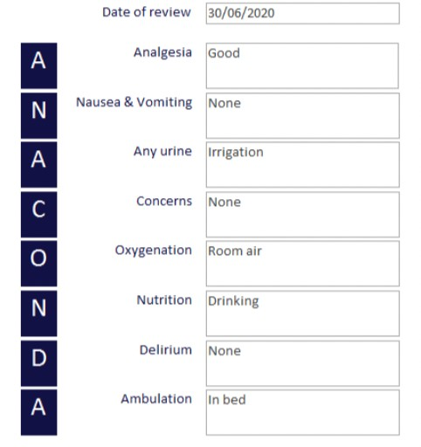
Post-operative review: why are we struggling to implement this ACSA standard?
Waddell E; Susnerwala I; Ghosh P; Jose A.
Introduction:
The Royal Bolton NHS Foundation Trust was awarded ACSA accreditation in 2017. It was noted at an annual visit following, that standard 1.4.4.2 was not being met which suggests that: ’Appropriate pathways are in place for the post procedural review of patients.’¹ The GPAS document states that patients meeting a particular set of criteria should be reviewed by an anaesthetist within 24 hours of their procedure. This criteria is:
“those graded as ‘American Society of Anaesthesiologists (ASA) Physical Status 3, 4 or 5’
those receiving epidural analgesia in a general ward
those discharged from recovery with invasive monitoring in situ
those for whom a request is made by other medical, nursing or other clinical colleagues
those for whom there is any other appropriate need.” These patients also need to be in hospital 24 hours later and have returned to the general ward post procedure.²
The team at Bolton aimed to achieve this standard, and a database was designed by consultants J.P Lomas and A. Putland to allow anaesthetic colleagues to input patients to be followed up the next day³. This database is named Anaconda and is an acronym for important parameters that should be assessed during the post- operative review. An example of such is shown here:
Methods:
The initial quality improvement project was then performed over a 3-week period in May 2021 to determine if we were meeting the standard using this database. All theatre lists were assessed to determine how many patients met the criteria and this was compared to the patients’ present on the Anaconda database. In our trust, no patients with an epidural or invasive monitoring return to the general ward so we included patients with a recorded ASA of 3-5. If the patient was found to be on the Anaconda database, we looked at the quality of the review and if it had been conducted within 24 hours.
A second data collection was performed over a 4-week period in September 2022 after further improvements were made which are discussed below.
Conclusions and Moving Forward:
It is clear from the results shown that we are still struggling to meet this standard. Looking at these findings in more detail, the aspect that requires the most improvement is adding patients to the database appropriately. Members of staff state that adding a patient to the database is uncomplicated and the database is easy to use . Despite this, the initial step of recognising the patient meets the criteria and remembering to add them to the database before they leave theatre is where most patients are lost.
We will continue with departmental education but going forward we hope also to try to improve this further by making the decision to be added to the database more MDT driven. We plan to include an Anaconda prompt as part of the surgical safety checklist and to include it in our handover to recovery staff. We also aim to inform members of staff on the ward of the reviews, so that more staff members involved in the patient's care are aware. One concern highlighted at our departmental meeting, was that the anaesthetist performing reviews may get involved in issues that would otherwise be referred to the parent team and this may lead to a breakdown in communication. Therefore, we must be extremely clear when documenting our reviews and refer onto the parent team where we see appropriate to do so.
A difference seen during the data collection that is not reflected in the overall results, is that there was an improvement seen in the number of reviews being completed once the patients had been added to the database. In May 2021, multiple patients were added to the database and a review was never attempted. In Sep 2022, 10 of the 12 patients added had an attempted review, but unfortunately only 5 of them were within the 24-hour period. Therefore, the addition of the allocated consultant on the rota has seen some improvement and we plan to continue this. Going forward, we hope to improve this further by expanding their role to include prompting colleagues to add patients to the database on the day.
Continued work is required to allow us to meet this standard, but we hope with these changes we will achieve this in the near future.
References
Results:
The initial data collection identified that 60 patients were eligible and should have been reviewed by an anaesthetist. 24 of those patients were added to the database but only 9 had a documented review within 24 hours.
Therefore, 15% of patients were reviewed appropriately.
Steps taken to attempt to improve this included:
Updating the departmental policy on post-operative review of patients⁴
Providing visual cues by placing stickers saying ‘Remember Anaconda’ on all laptops used in theatre
Including Anaconda training during induction of new trainees
Allocating a consultant to post-op reviews, supported by the on-call team if available.
This was repeated in September 2022 and 89 patients were identified to be eligible. Only 12 of these were added to the Anaconda database and of the 12 patients only 5 had a review within 24 hours. Therefore, 5% of patients were followed up appropriately.
15% 5%
Educating the department on how to use the database occurred and the use of the database commenced in 2019.
1.
2.
The Royal College of Anaesthetists. Anaesthesia Clinical Services Accreditation. Accreditation Standards 2022. https://www.rcoa.ac.uk/sites/default/files/documents/2022-07/ACSA-STDSFULL-2022.pdf. P84-85. Accessed Feb 28th 2022. The Royal College of Anaesthetists. Guideliens for the Provision of Anaesthesia Services. https://rcoa.ac.uk/sites/default/files/documents/2020-02/GPAS-2019-04-POSTOP.pdf. Chapter 4, P6. Accessed March 1st 2022.
Putland A., Lomas J.P. ANACONDA database. Royal Bolton Hospital ,2019
Susnerwala I. Post-procedure Review of Anaesthetic Patients. The Royal Bolton Hospital, Dec 2021.
3.
4.

